Slide 1

Profitability Analysis of growing a B2C
BUSINESS
Vishnu Kariyattu

Slide 2

Class Concept :
Cost Analysis and Breakeven
BACKGROUND
"I have a seafood business in India that operates on a B2C model. We have eliminated the need for a wholesaler by directly procuring fish from fishermen and selling it to customers. This approach is beneficial as it allows us to sell the fish at higher margins. Additionally, customers receive fish that is fresh, of premium quality, and free from preservatives.”
Current Scenario
Shop No 1 (monthly):
Average Revenue : $ 11,330
Average Qty of Fish Purchased: 2900 lbs.
Average Revenue per pound : $ 3.90
This is achieved when the business operates for 26 days in a month and purchasing occurs on 13 days in the month.
Note: "Purchasing Power Parity (PPP adjustment= 22.95) is utilized to equate currencies and provide a comparable economic understanding within a U.S. context ."
Notes:
Source of PPP converter: https://www.imf.org/external/datamapper/PPPEX@WEO/OEMDC

Slide 3

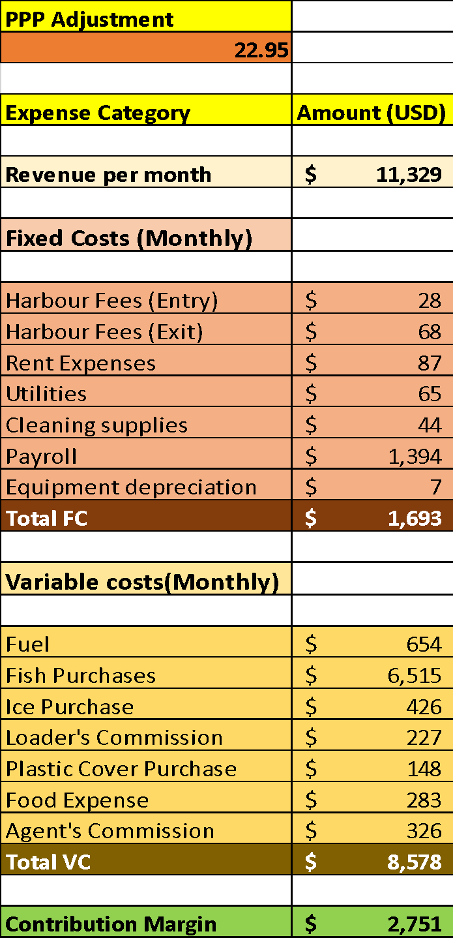
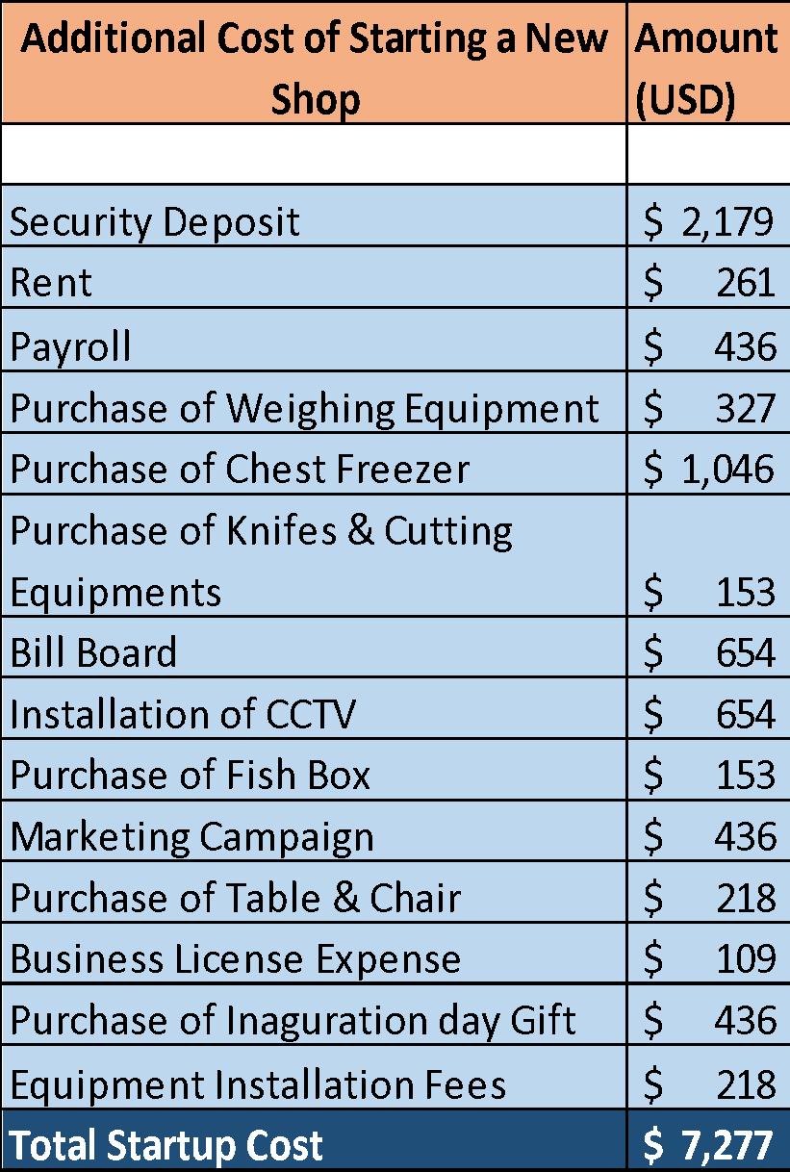
Cost Analysis

Slide 4

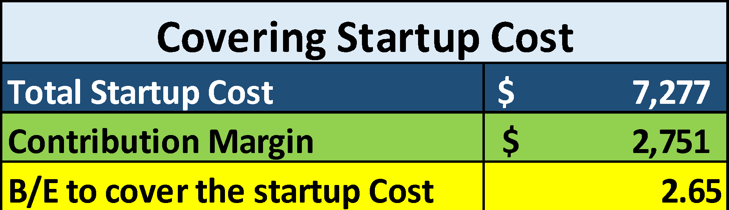
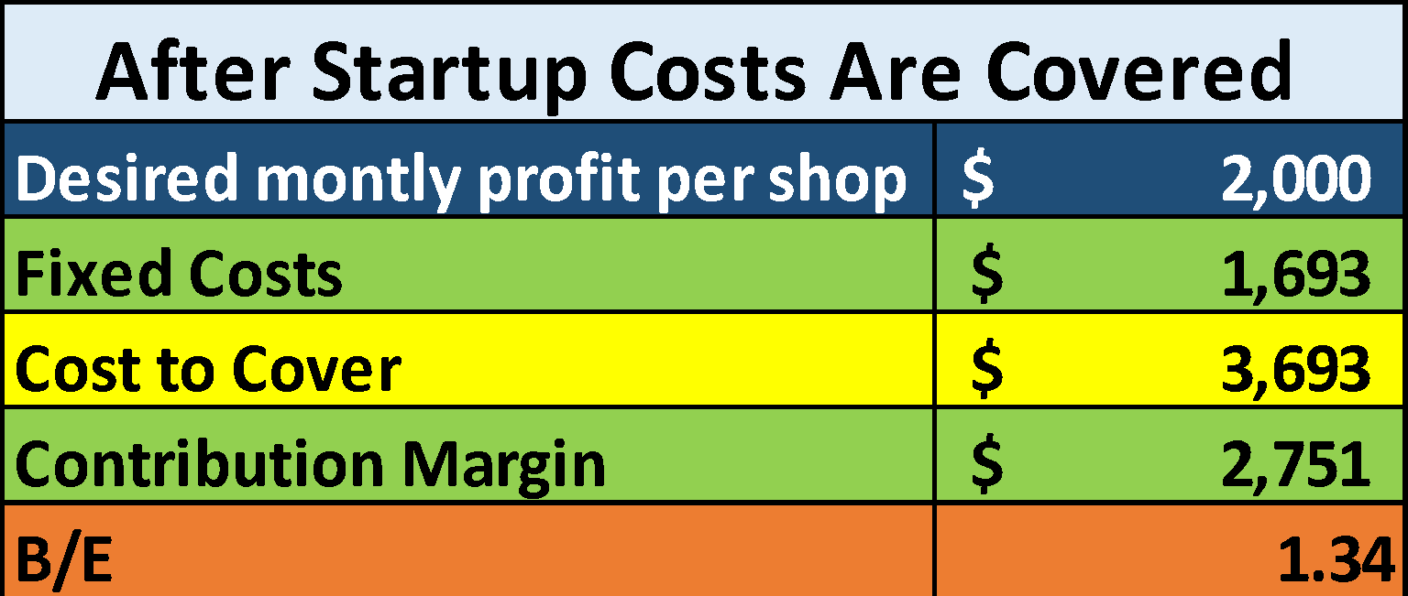
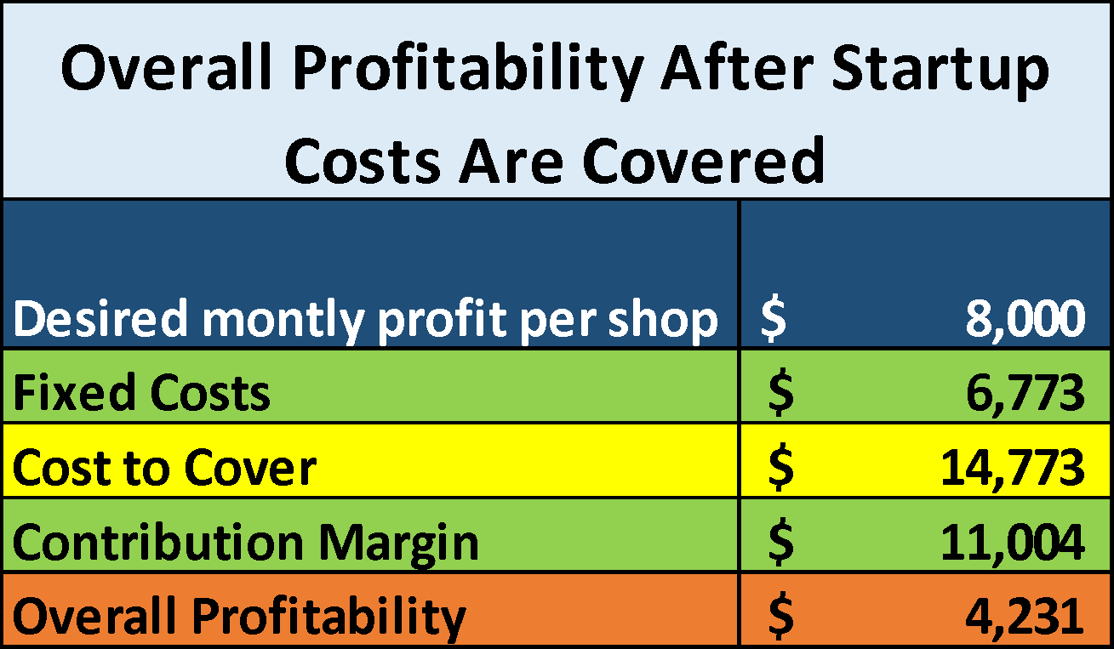
Breakeven Analysis
This means that, on average, I will take 2.65 months to just cover my startup costs.
To interpret this, for every $1.00 of fixed cost, the shop needs to generate $1.34 in sales revenue that contributes to covering these costs. After reaching the break-even point, any additional contribution margin contributes to the profit.
In this particular route, between the Harbor and the shop no 1, I can start another 2 more shops with the existing storage capacity and transportation expenses.
This is the total profit above fixed costs but not accounting for any additional variable costs that might increase with more shops.

Slide 5

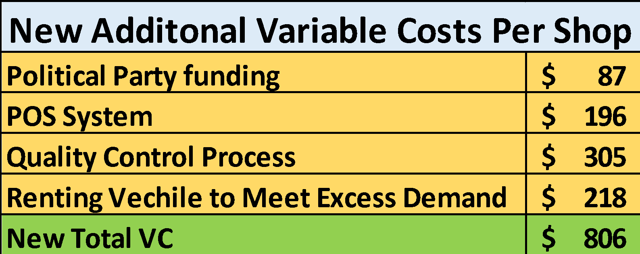
Concerns With The Analysis
The analysis shows potential profitability; however, it does not account for various operational factors such as:
Seasonal variability in the availability of fish
Product losses due to spoilage
The assumption that process quality will be maintained during scaling
The need for technology upgrades
Additional resources to meet increased demand or variability.
and economic factors such as:
Inflation
Regulatory changes
Political influence in the area
Potential economic downturns, like recessions.

Slide 6
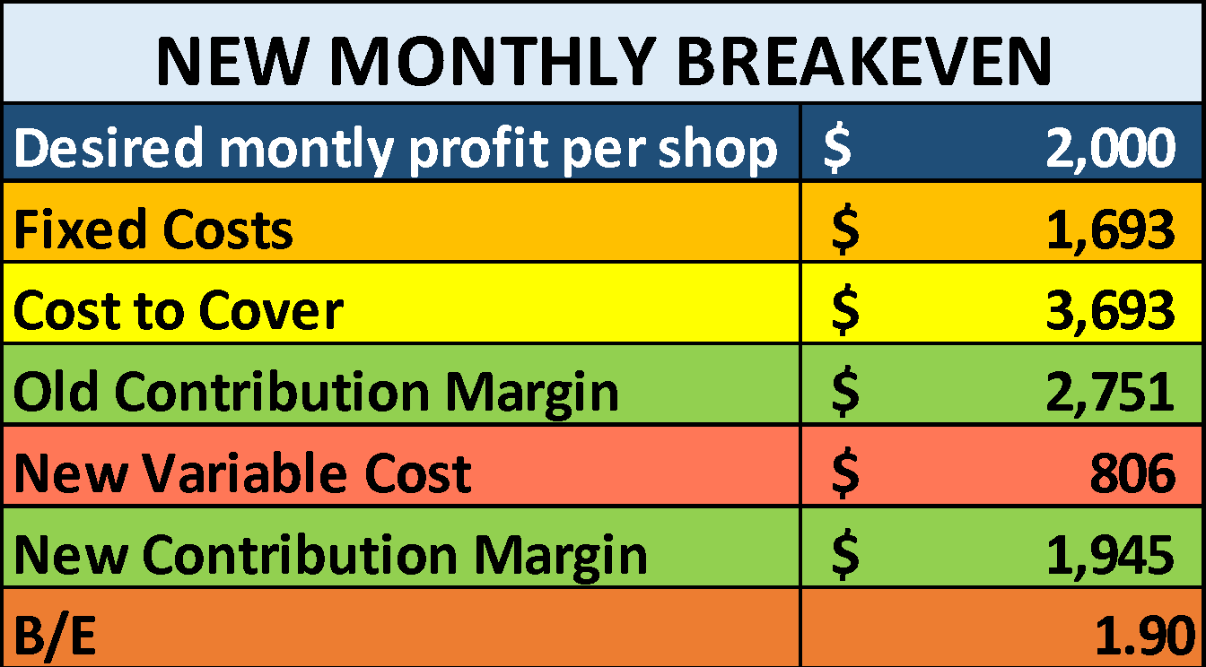
Viability
Advice
With the new Variable Costs in mind, my business would need to generate $1.90 for every $ 1 spend on Fixed Costs instead of earlier amount of $ 1.34 that was there before the analysis was conducted. There is a 42% increase, this means that we must sell more to achieve higher sales revenue to maintain profitability.
In terms of business viability, this points us to the following options:
Increased Sales Efforts
Cost Management
Pricing Strategy
Process Improvement
Risk Management
Starting a business, especially in the seafood industry, which is subject to a variety of operational and market variables, requires thorough planning and flexibility.
Have a Comprehensive Business Plan that covers market analysis, competition, pricing strategy, operational model, and financial projections.
Keep a tight leash on the expenses of the business, while maintain a financial cushion to sustain the business through its initial stages and ensuring quality is maintained.
The business should have an adaptable and responsive go-to-market strategy, along with pricing plans that are equally adaptable and responsive.
In my case, had I not planned for the additional turmoil in the business and maintained a cash reserve, I would have gone out of business. This analysis prompts me to exercise extra caution when expanding my business, a practice that all startups would be wise to adopt

